Slide 1
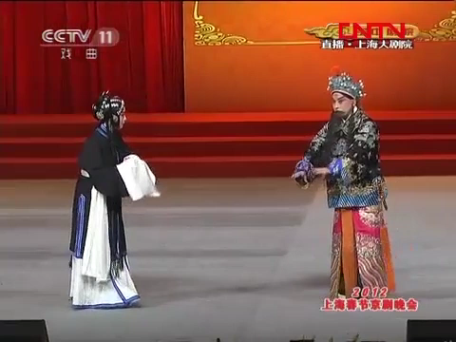
Video: 孟庆丰
Voice：竺童
Content：陈雙筑 韦美玲 周富琦

Slide 2
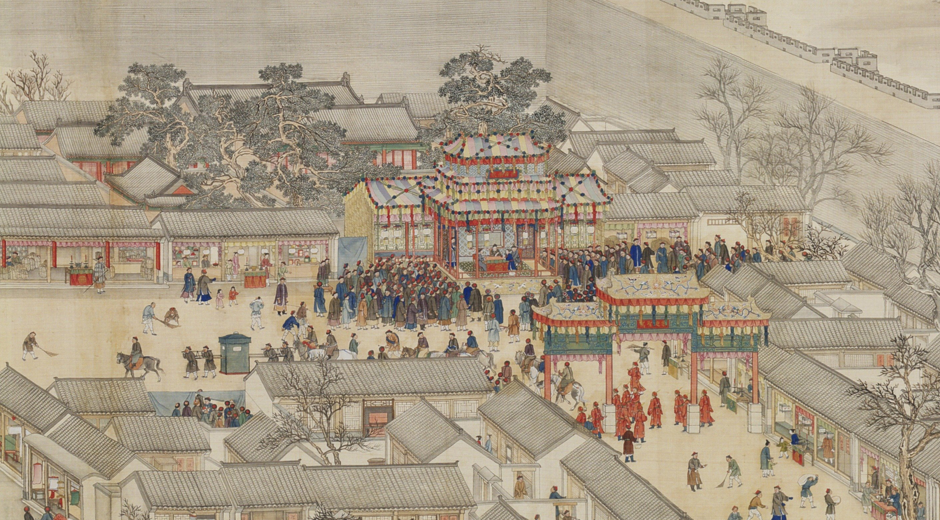
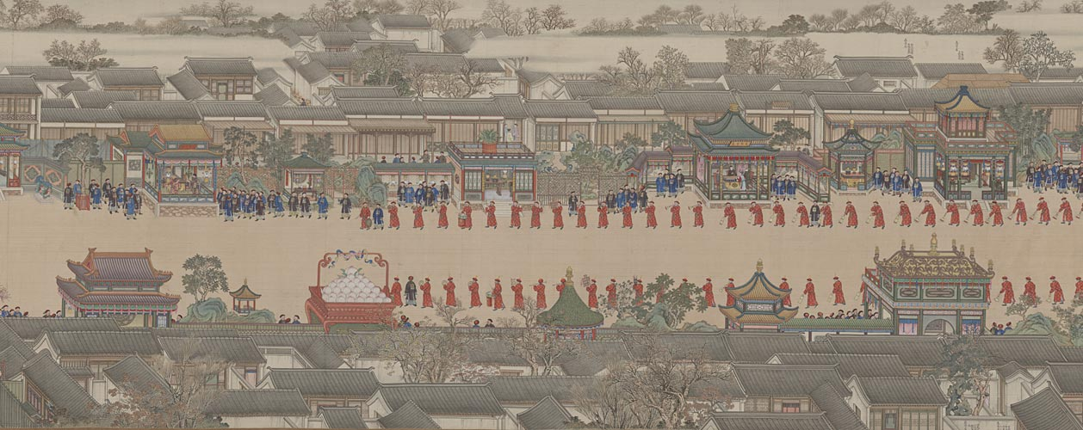
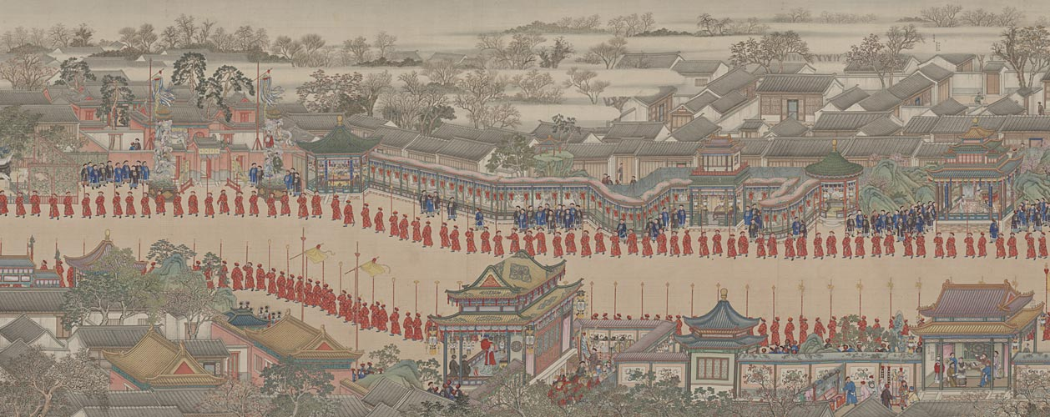
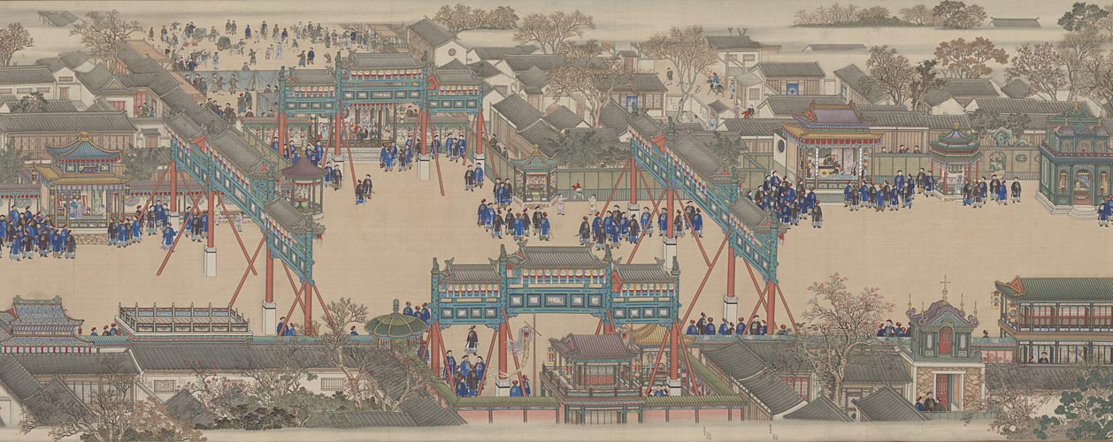
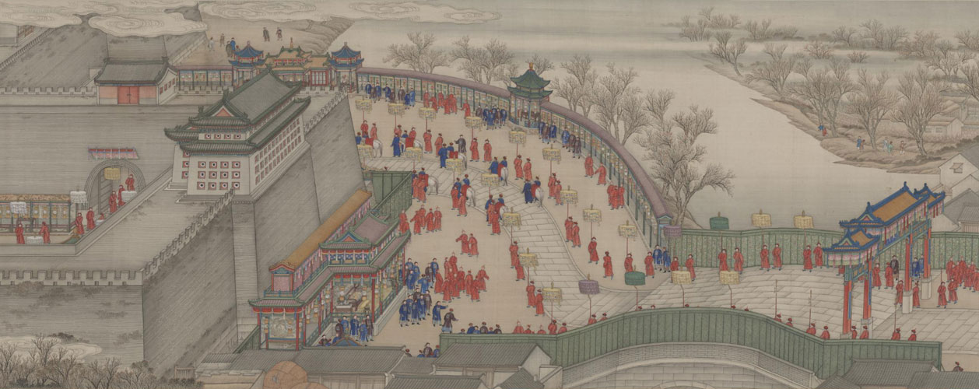
"Longevity Celebration of Empress Chongqing"
"The Qianlong Emperor's Southern Inspection Tour, Scroll Two"
Opera flourished in the Qianlong period of the Qing Dynasty. In the fifteenth year of Qianlong (1751), October 25 was the sixtieth birthday of Empress Dowager Chongqing, the mother of Hongli, Emperor Gaozong of Qing Dynasty, for which Qianlong held a grand celebration.

Slide 3
文戏
(Civil)
武戏
(Military)
History, Legend, and other Works of Literature

Slide 4
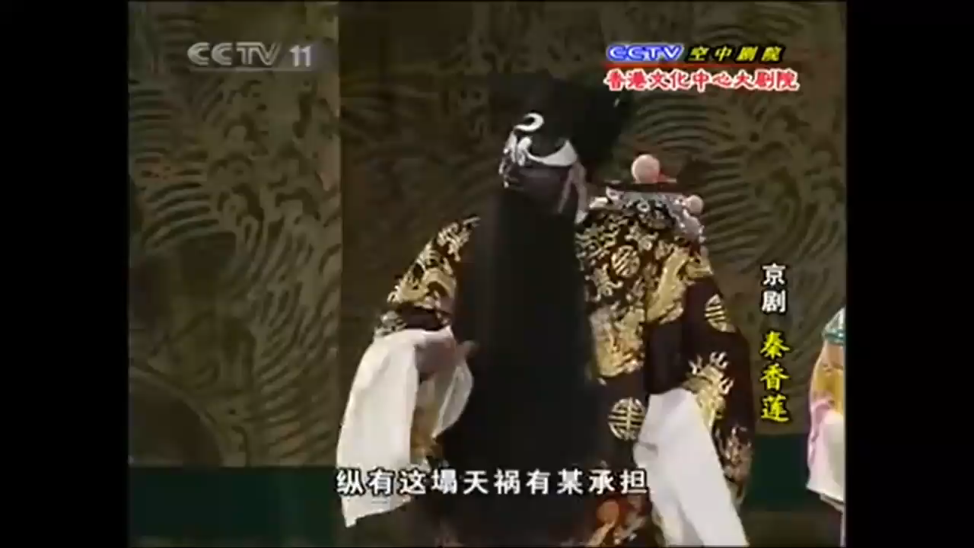

Slide 5



Contents
Teaching
context
Teaching
objectives
&
method
Teaching
procedure
Teaching
highlights
Teaching
presentation

Slide 6
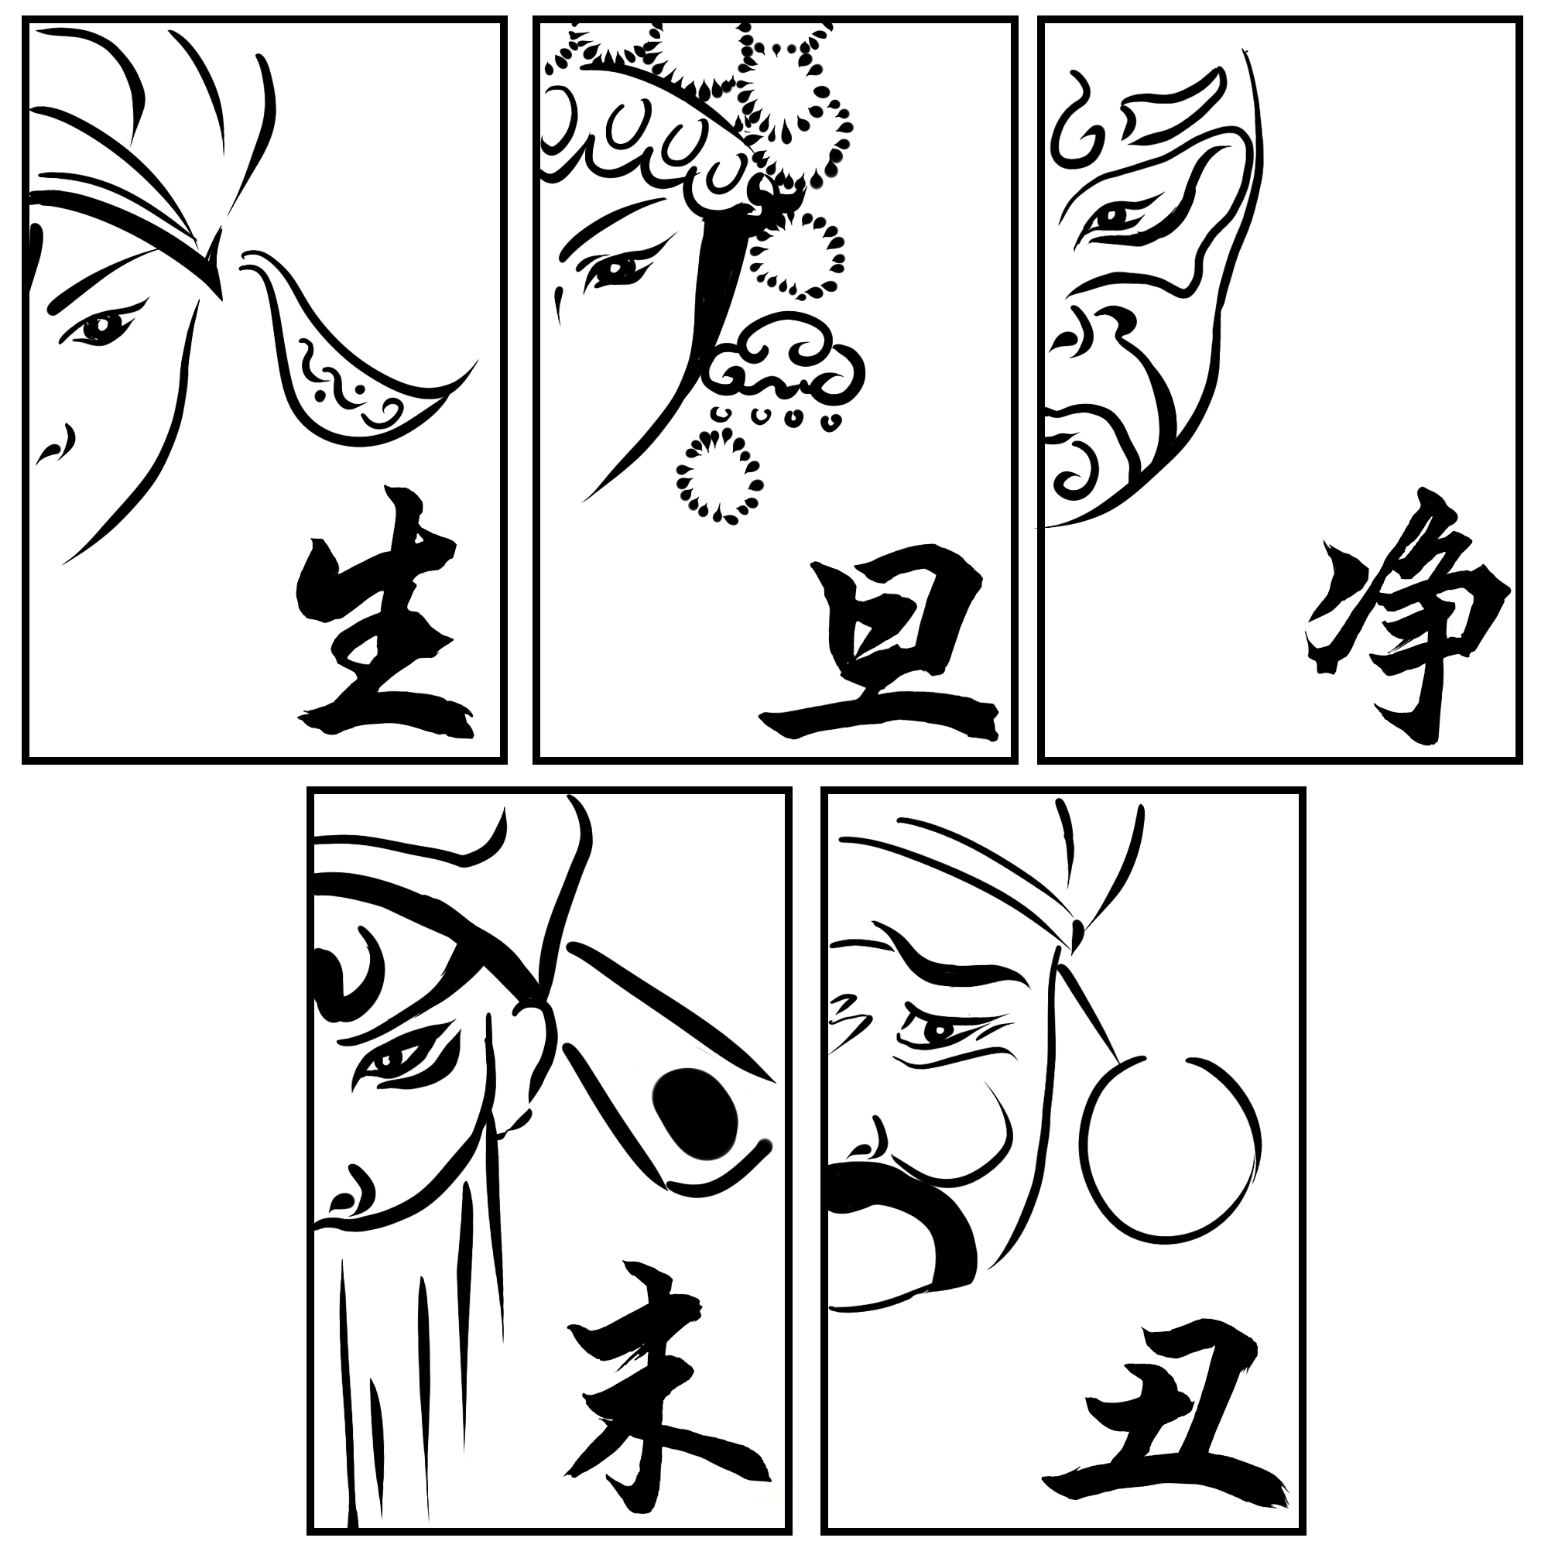
ZHENGDAN (main female role)
GUIMENDAN (unmarried young girl)
DAOMADAN (female warrior)
HUADAN (vivacious and unmarried)
LAODAN (senior clever woman)
WUDAN (acrobatic)
LAOSHENG (elderly)
WUSHENG (military)
XIAOSHENG (young)
HONGSHENG (red-faced)
WAWASHENG (young boy)
ZHENGJING (leading)
FUJING (Assisting)
WUJING (military jing)
WEHNCHOU (civil)
WUCHOU (military)
Sheng
Chou
Chou
Dan
Jing
Dan
Jing
(Men)
(Women)
(Clown)
(Women)
(Clown)
(Painted Face Roles)
(Painted Face Roles)
Notes:
Dan的时候补充一下，不让女的演

Slide 7
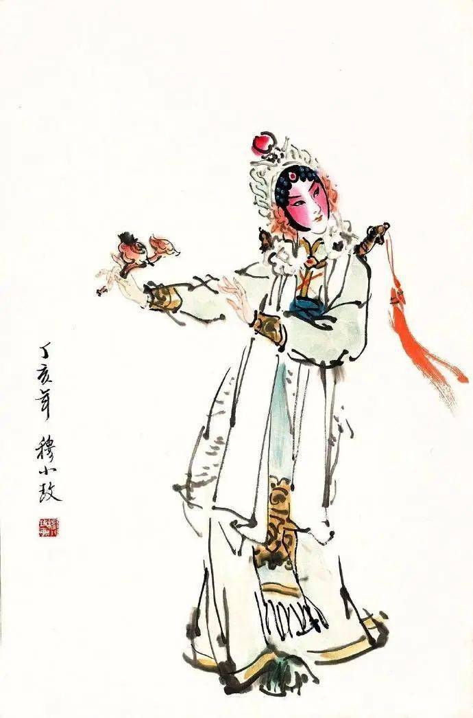
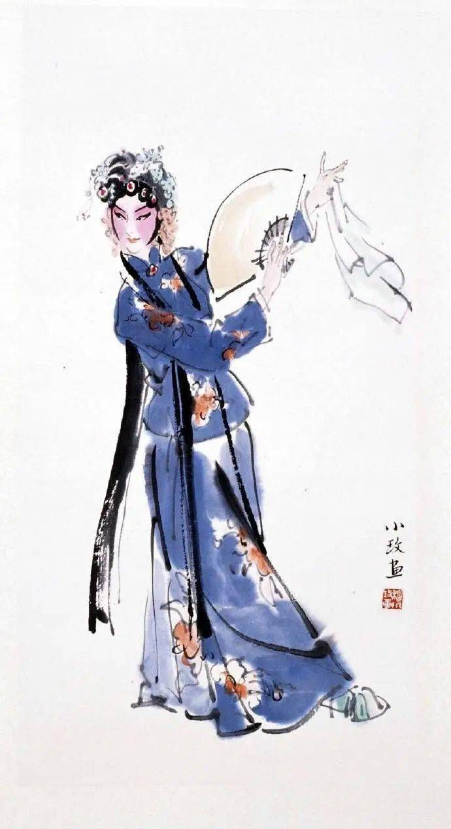
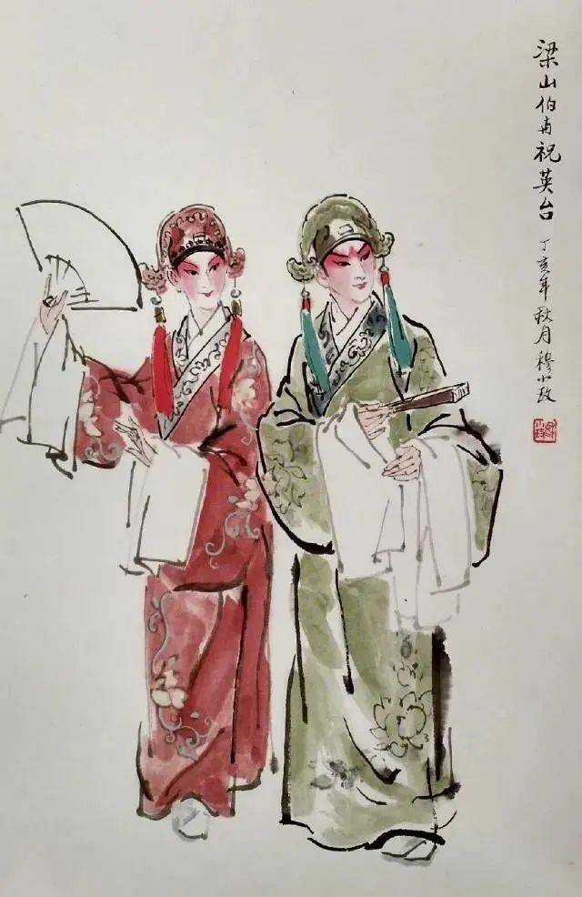
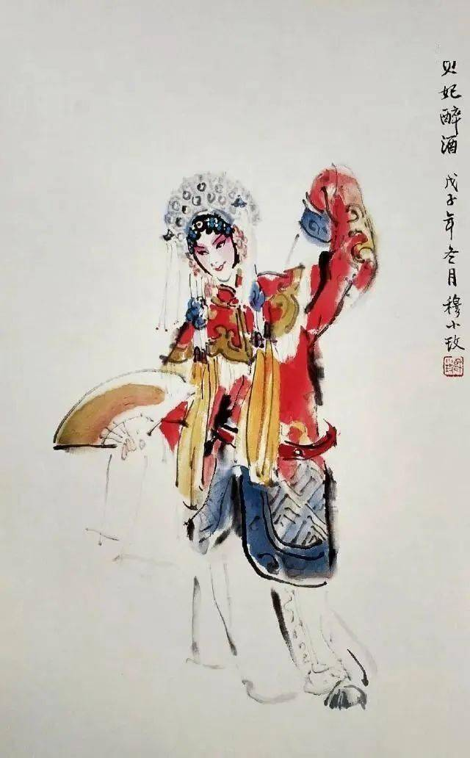
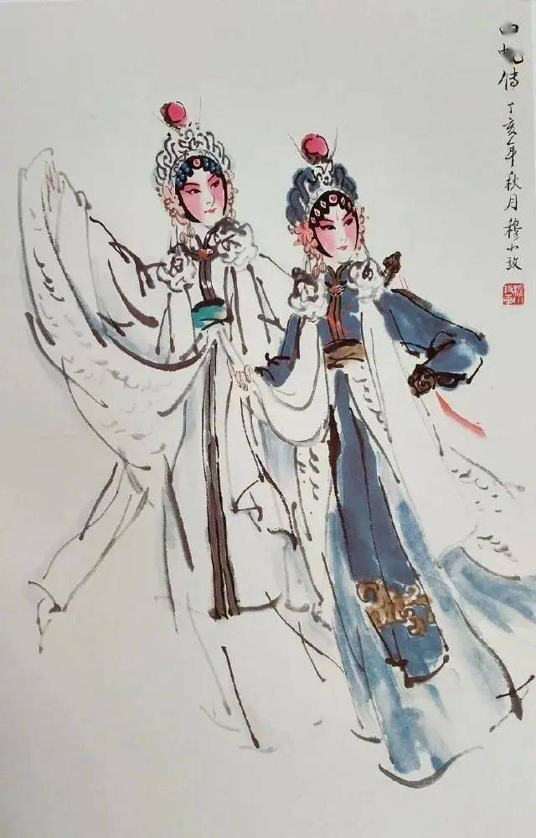
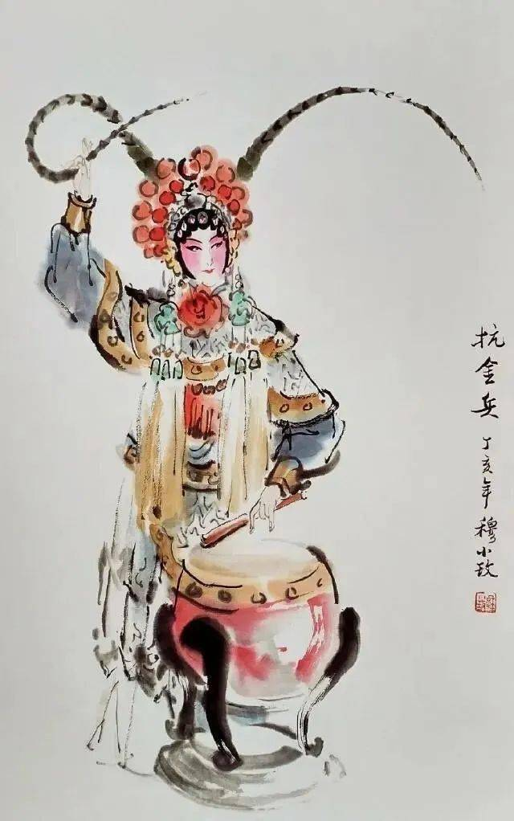
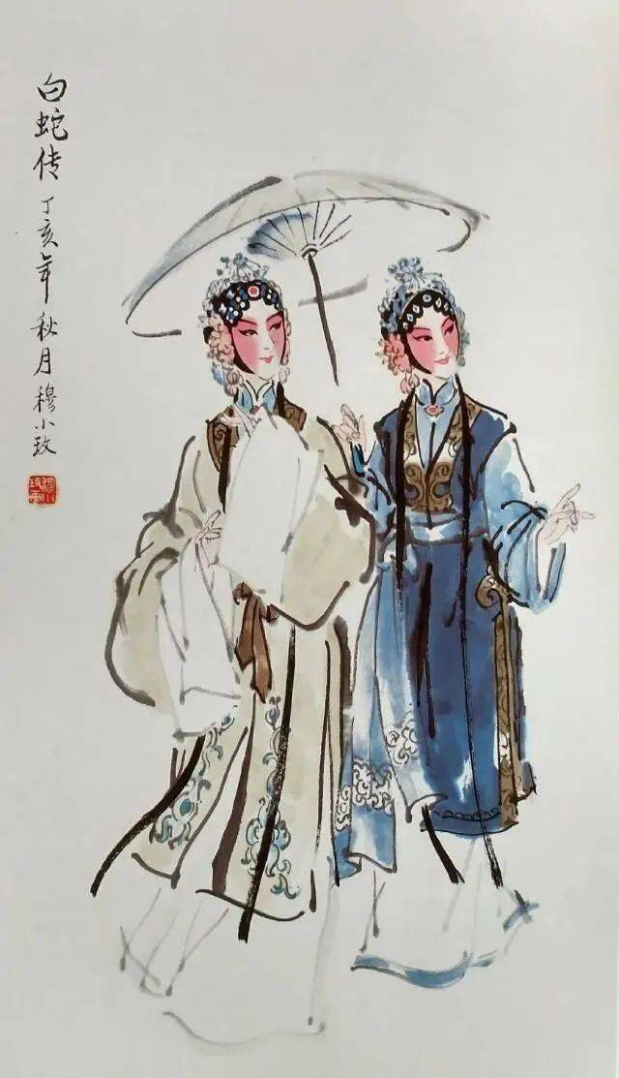
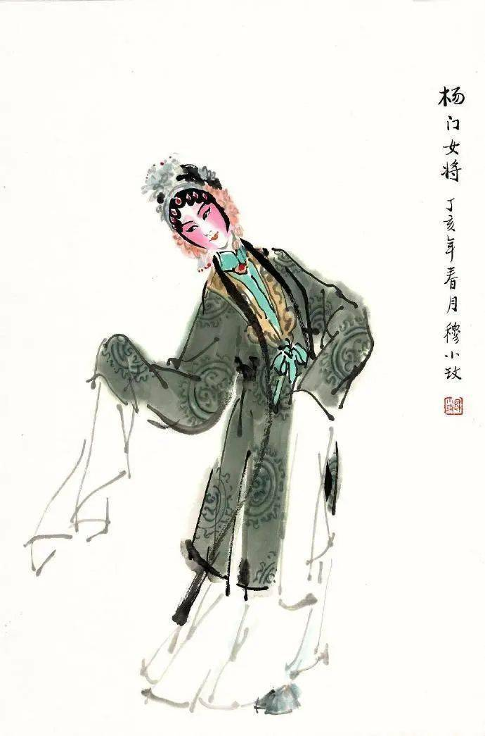
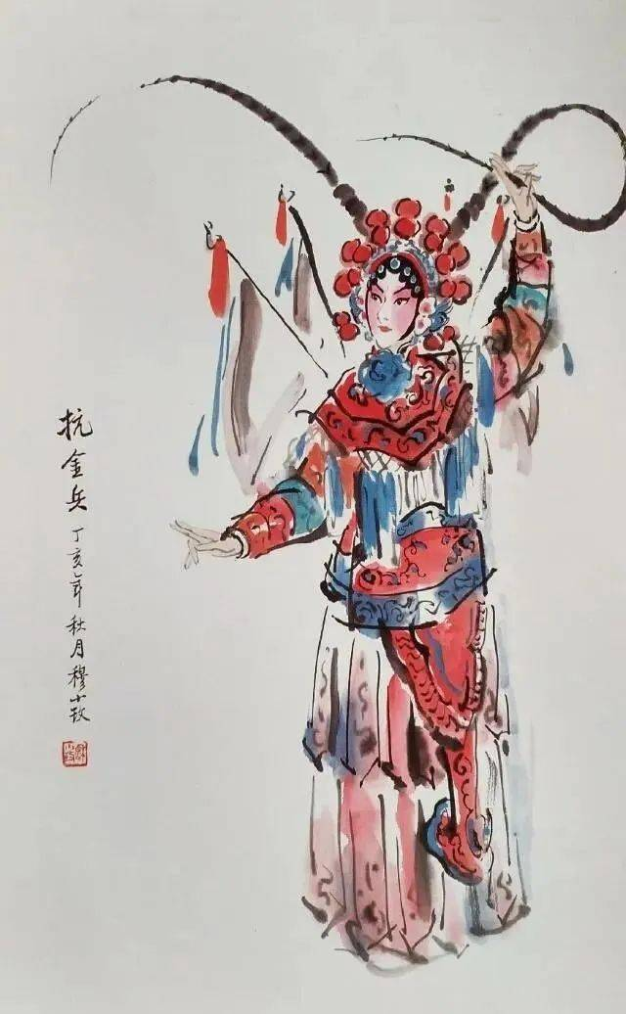
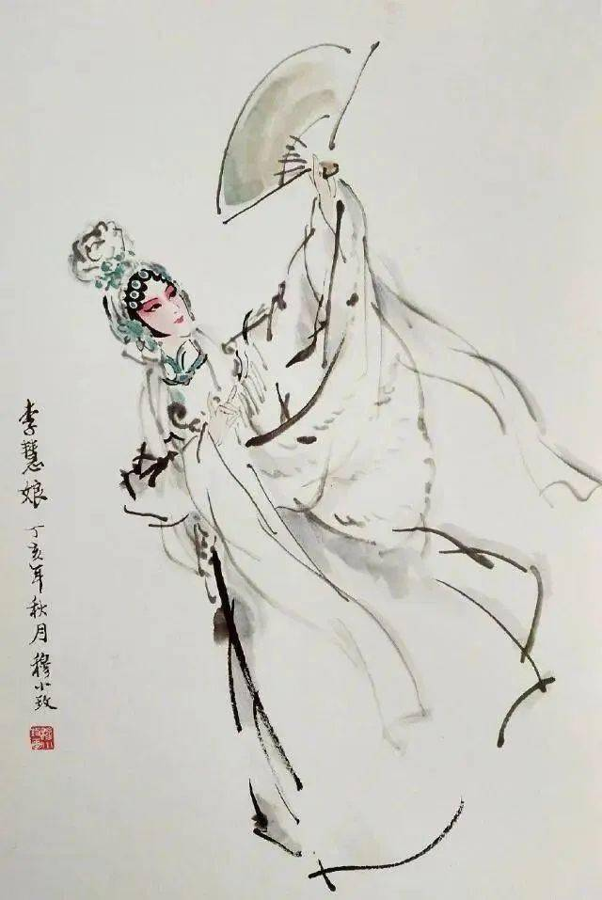
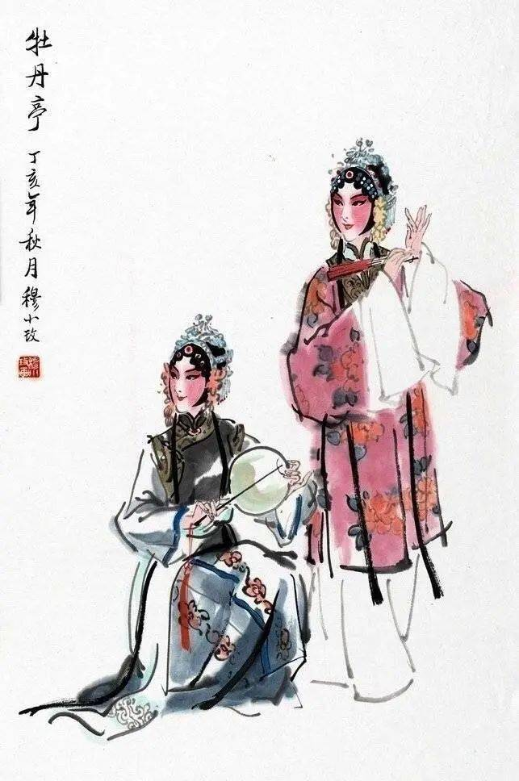
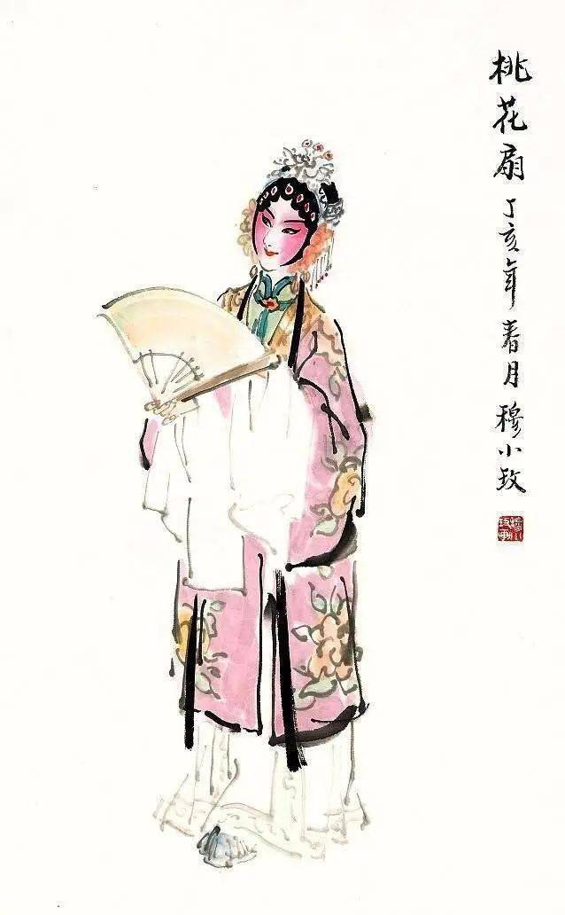
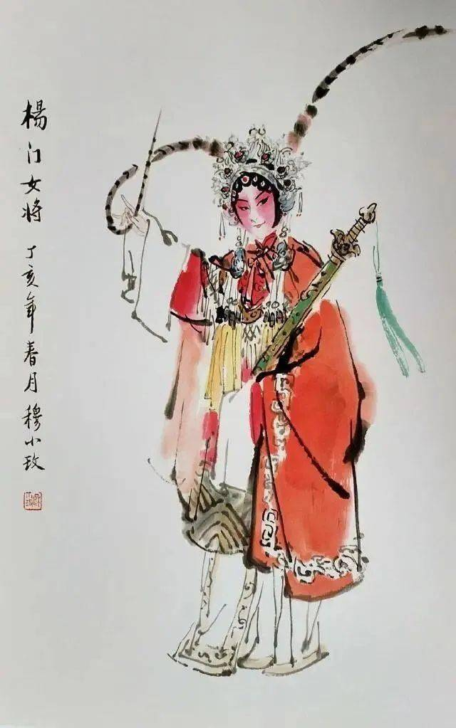
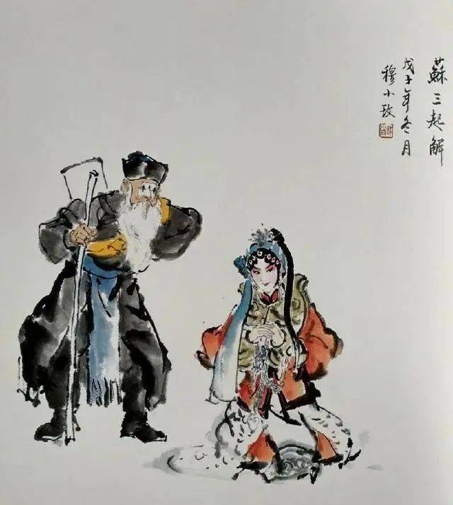
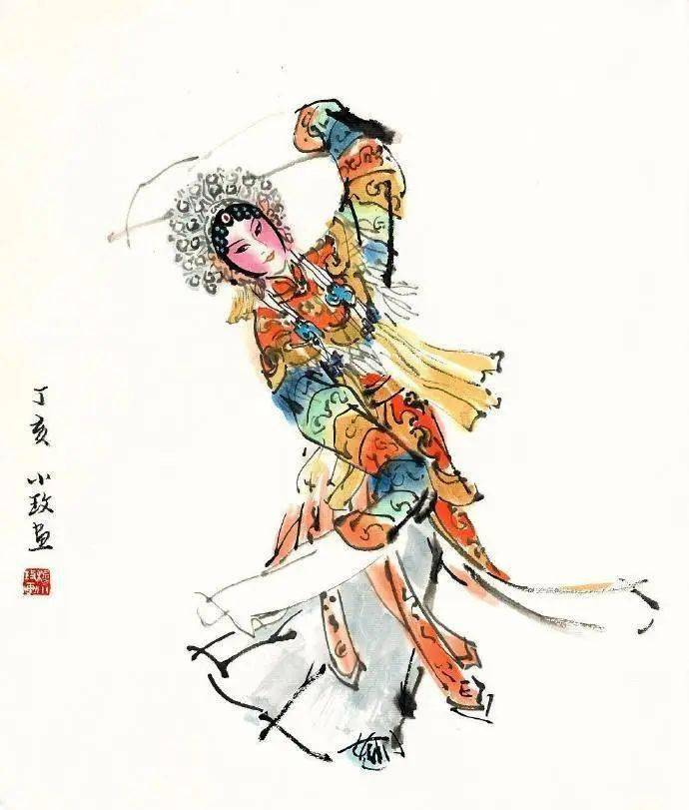
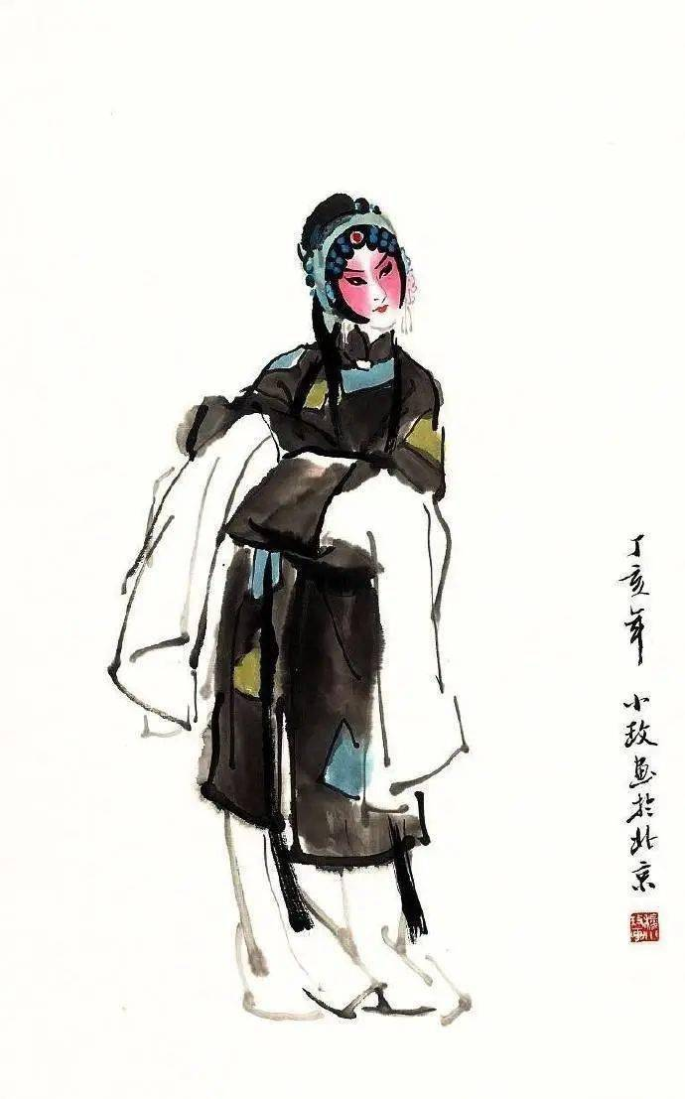
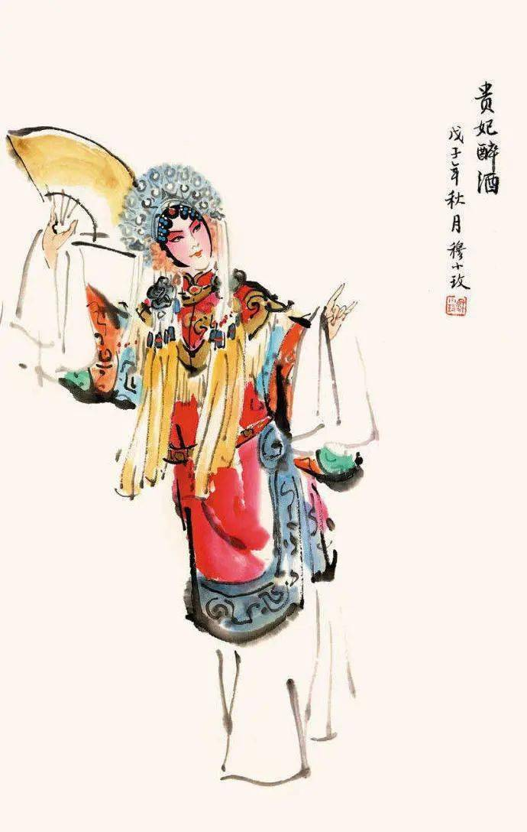
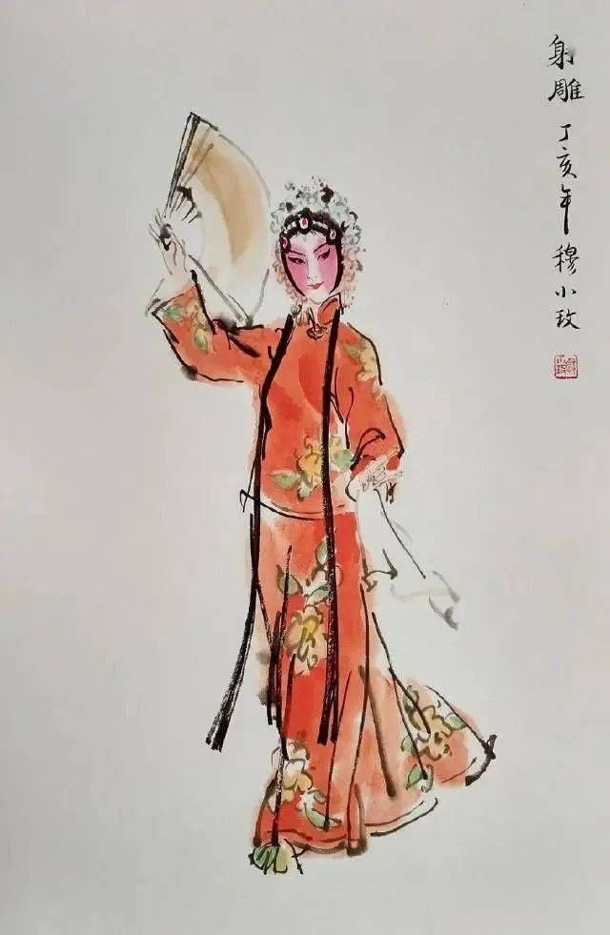
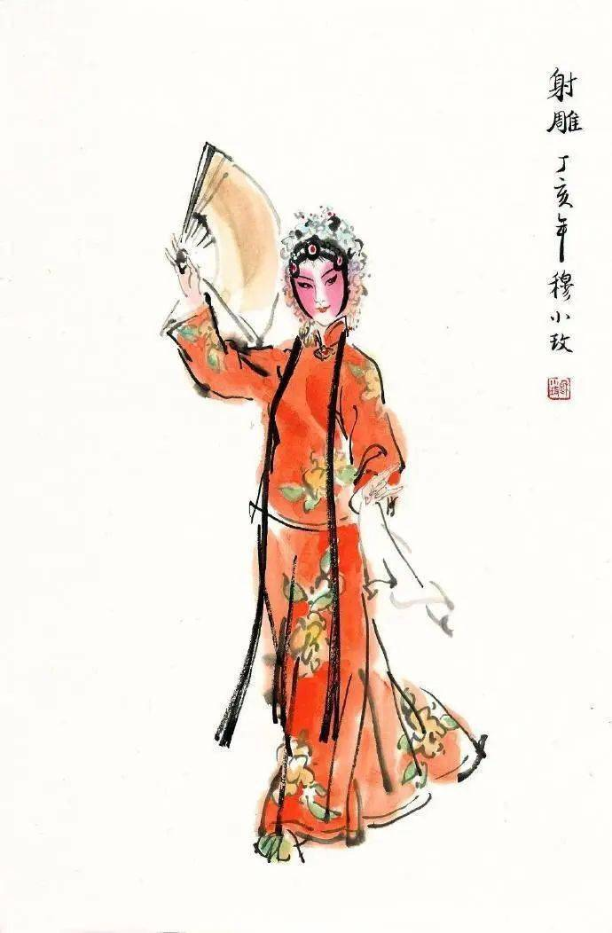
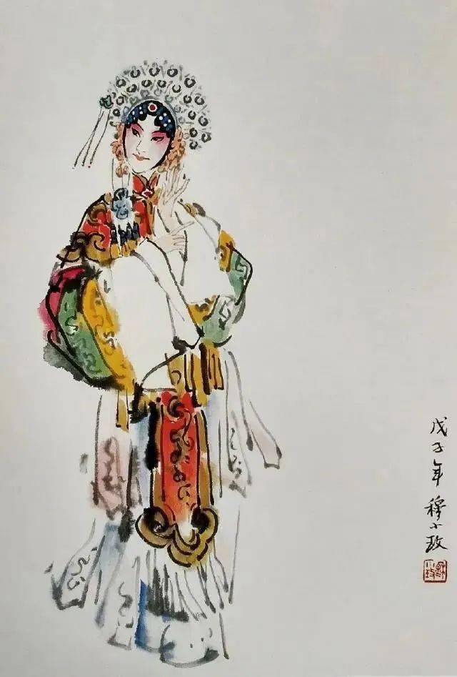

Slide 8
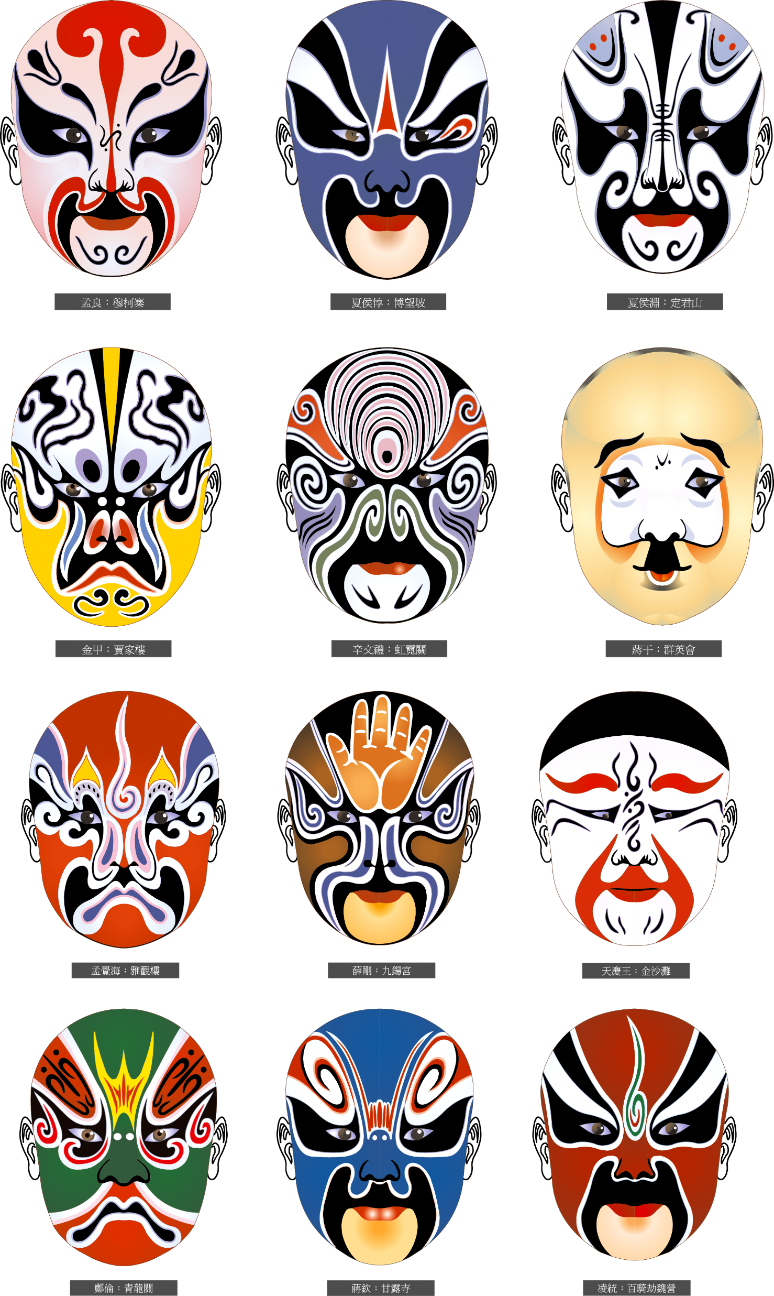

Slide 9
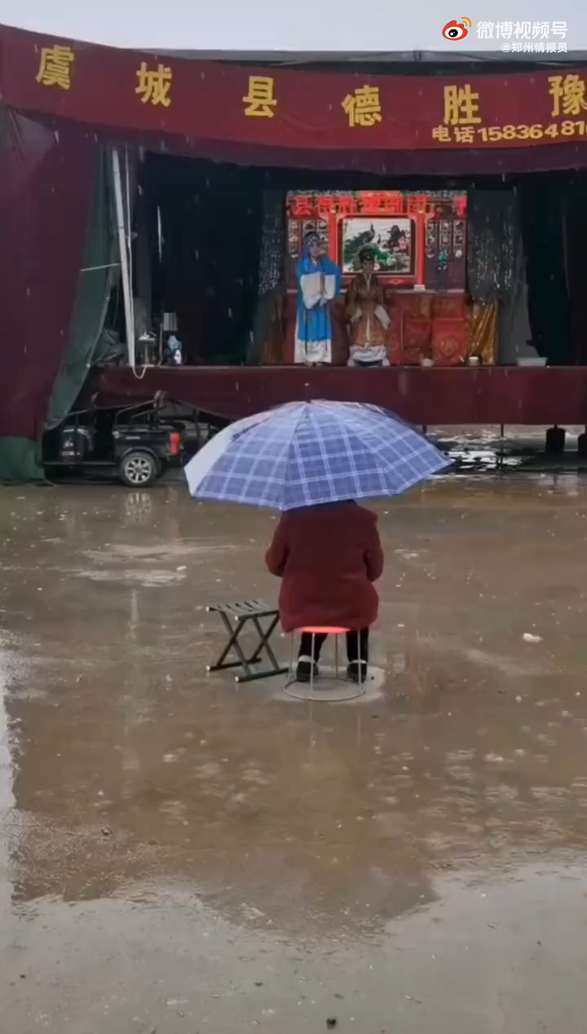

Slide 10
